Slide 1
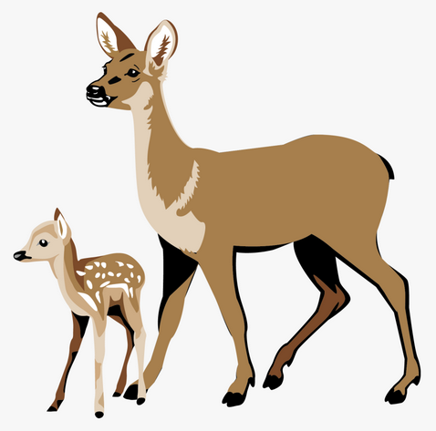
COMMUNITY-BASED DEER MANAGEMENT PLAN
For the
CITY OF ONEONTA, NY
Sandy Bright
Susan Brunswick
Joann Chmielowski
Joe Chmielowski
Betsy Holland
Susan Lettis
Wendy Miller-Willis
Marjorie O’Mara
Catherine Paluch
Tom Travisano

Slide 2
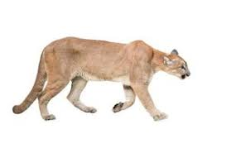
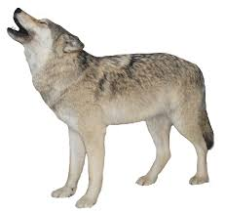
Background
19th Century: U.S. deer population decimated, 95% wiped out by hunting and deforestation.
Success in New York: by mid-20th century deer were outstripping their natural food supply in many areas.
Natural controls to populations:
food supply
Predation
Disease
Weather
Hunting (~210,000/yr.) and collisions with vehicles (~65,000/yr.) are now the main controls: Not enough to keep the population at sustainable levels.
https://www.dec.ny.gov/animals/104911.html

Slide 3
MISSION
Gather current opinions of city residents about deer.
Research the effects of the increasing deer population on the city, the environment, and the deer.
Study mitigation strategies; recommend those most appropriate to our area.
Educate the public about the problems and potential solutions.

Slide 4
Process
Conducted a city-wide survey (derived from surveys created by Cornell University)
Presented a public forum by representatives of the DEC about deer management
Obtained information from other communities in New York which implemented deer management plans
Reviewed research on the effects of deer overpopulation on deforestation, relationship to tick-borne illnesses, incidence of deer/car interactions and the health of the deer herd

Slide 5
Survey Results
Respondents rated as very important:
Opportunities to view or photograph deer: 27%
Health and well-being of deer: 59%
Negative impacts of deer on people: 75%
Negative impacts of deer on environment: 74%
Problems with hunters: 47%
Respondents who have been affected by:
deer damage to gardens and plantings around their home 89%
tick-borne disease 38%
deer-related accident 88%
Survey derived from surveys created by Cornell University
Goals of this survey:
gauge current public opinion on deer
raise awareness of the issue.

Slide 6
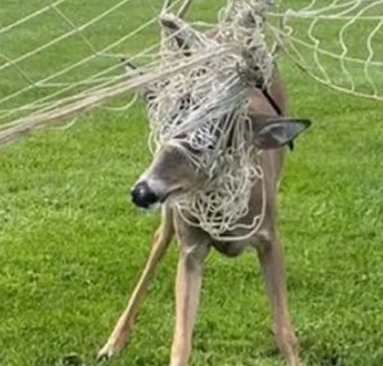
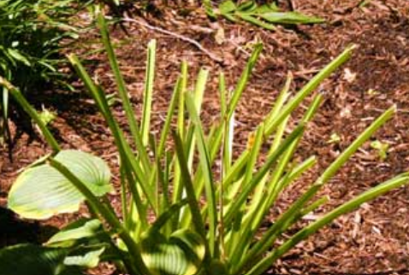
Problem Definition
Health of the deer herd
Injuries to deer through interactions with human environment
Damage to gardens and landscaping
Lyme and other tick-borne diseases
Deer/vehicle collisions
Overbrowsing, resulting in erosion and flooding
Damage to forests and farm crops
Decreased biodiversity
Problems determined from results of survey and complaints/concerns brought to the attention of various entities in the City of Oneonta

Slide 7
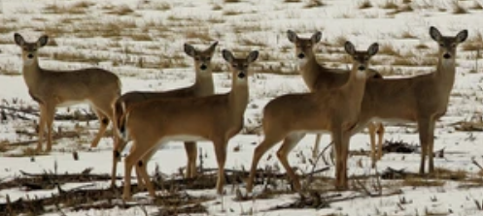
Deer in lower-density populations tend to be healthier.
High-density populations harm deer through:
Increased transmission of diseases and parasites
Increased competition for food
So would it help the deer to feed them?.
https://www.dec.ny.gov/animals/104911.html

Slide 8
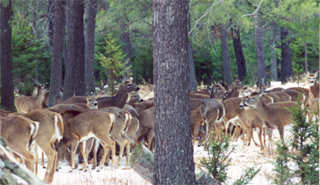
Killing the deer with kindness
Why not feed the deer?
It is illegal to feed deer in New York State for the following reasons:
Deer digest food with the help of microbes
in their stomachs that change with the seasons.
Feeding them may actually cause starvation.
Feeding deer brings them together, increasing the spread of disease such as chronic wasting disease.
Because they become accustomed to humans, it increases the chances of spreading tick-borne diseases, deer/vehicle collisions.
https://www.dec.ny.gov/animals/7197.html

Slide 9
GOALS of the Deer Management Policy
The goal of the Deer Management Plan is not to eliminate deer. The goal is to:
Safely and effectively reduce the deer population to a sustainable level
Maintain a socially acceptable level for the deer population
Revitalize native plants and preserve healthy local forests and farmlands
Decrease property damage
Decrease deer/car collisions
Decrease tick exposure
support a community that is well-educated on living with deer while reducing human-deer conflict.

Slide 10
So how do we know there’s a problem here?
Corroborating Information:
Deer-related accidents
Occurrence of tick-borne illnesses
Effects of deer overabundance locally on the environment
* Because neither we nor the deer are isolated, we felt it appropriate to include information from outlying areas rather than limiting it to the city. We have been unable to find much current data on our specific local area, but the trend for all areas has been upward in recent years.

Slide 11
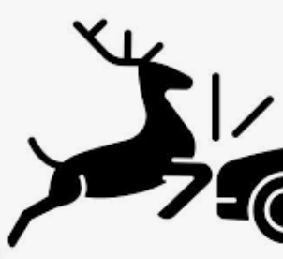
DEER-RELATED ACCIDENTS
In 2017, Oneonta was ranked the 27th most likely city in upstate New York to have a deer/vehicle collision, according to The National Insurance Crime Bureau.
Statewide, the odds a New Yorker will hit a deer are 1 in 161, and collisions can cost drivers thousands of dollars.
https://www.newyorkupstate.com/news/

Slide 12
Who needs a car in order to have a deer accident?
Video captured by security camera at the Oneonta High School

Slide 13
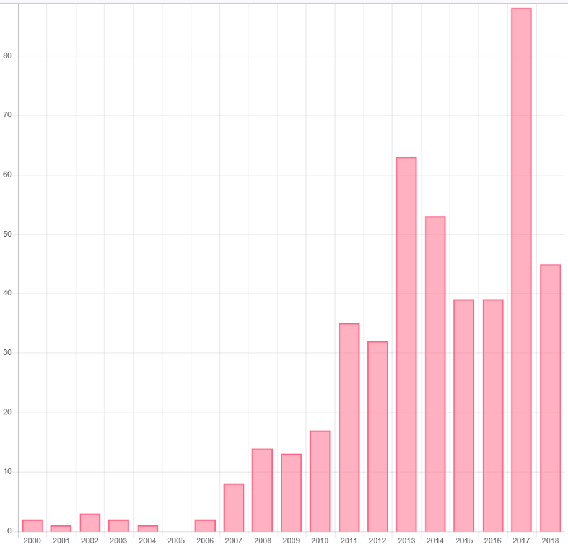
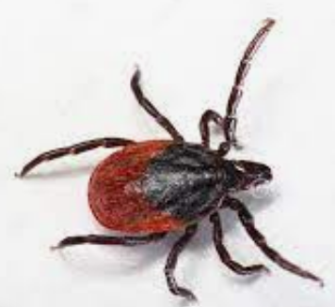
CONFIRMED cases of Lyme disease in Otsego County
from 2000 – 2018
The actual number of Lyme disease cases may be 10 times greater.
https://www.tickcheck.com/stats/county/new-york/otsego-county/lyme
Average 1.6 cases/year
Average 54.7 cases/year

Slide 14
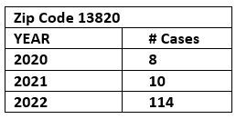
In the first 10½ months of 2022, there have been 114 confirmed cases of Lyme disease IN ONEONTA ALONE, more than twice the cases in the entire county a few years ago.
Thanks to Diane Georgeson for getting us the most recent statistics, reported as of Nov. 16th, 2022.
The relationship between deer density, tick abundance, and human cases of Lyme disease in a residential community 13-year study conducted in a Connecticut community
According to this study, the number of Lyme disease cases was strongly correlated to deer density. Reducing deer density to 5.1 deer/km² resulted in:
76% reduction in tick abundance,
80% reduction in resident-reported cases of Lyme disease

Slide 15
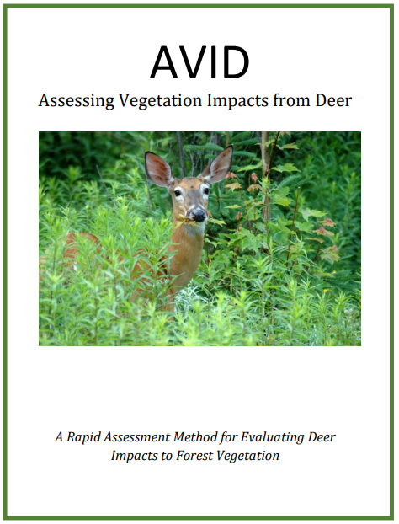
Forest Impact Monitoring:
Very simple, minimal training
More scientific, requires commitment
Watershed Agricultural Council, U.S. Forest Service, NYC Environmental Protection Agency
https://aviddeer.com/files/AVID_Manual_2020.pdf
https://mywoodlot.com/images/supporting_information/deer_browse_survey.pdf

Slide 16
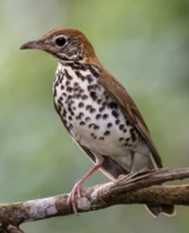
Signs that a forest may be suffering from too many deer include:
Impacts of deer over-browsing on bird populations
• An open, park-like appearance under the trees • Lack of spring wildflowers like trillium and jack-in-the-
pulpit • Forest floor covered with grass, ferns or invasive plants • Lack of young trees between 1 and 5 feet high • A visible browse line: no green leaves below 5 feet off
the ground
https://www.dec.ny.gov/docs/wildlife_pdf/forestimpactshandout.pdf
Wood Thrushes are dependent on the understory of the forest for nesting.
Cornell Lab of Ornithology

Slide 17
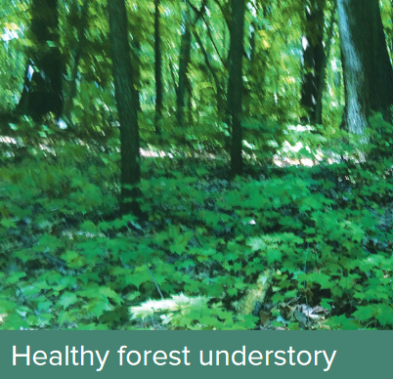
Sparse understory with little variety
Understory of herbs, shrubs, tree seedlings and saplings
https://www.dec.ny.gov/docs/wildlife_pdf/forestimpactshandout.pdf

Slide 18
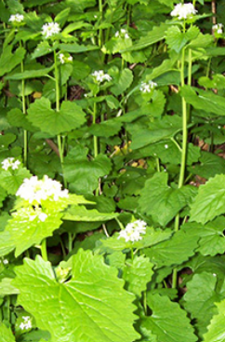
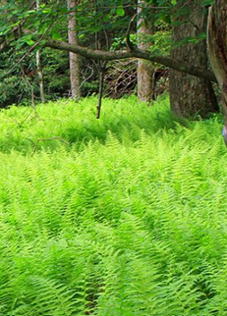
Garlic Mustard
invasive species
Deer rarely eat ferns, so even native ferns can become invasive when deer browse more nutritious plants around them.

Slide 19
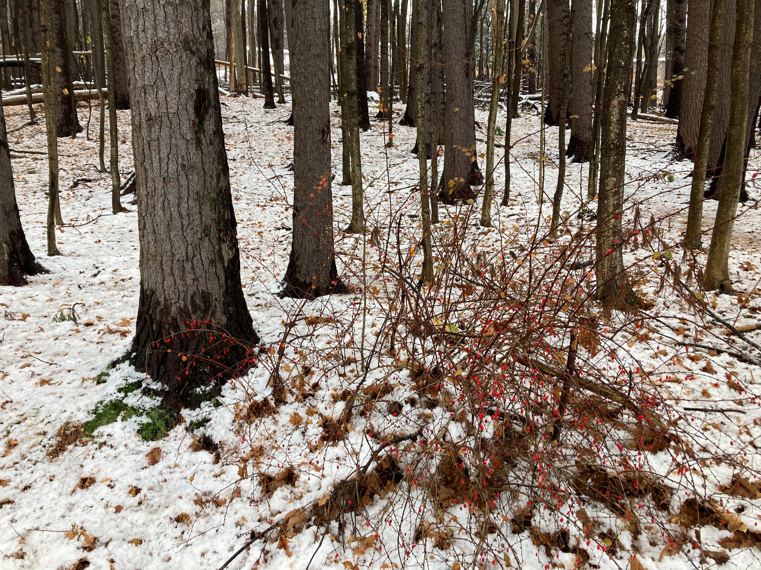
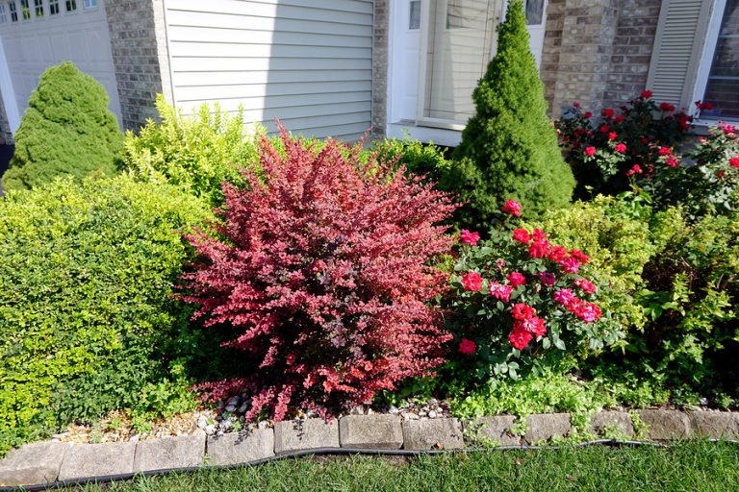
Japanese Barberry
Invasive species
All varieties of barberry host white-footed mice and ticks.
Barberry is increasingly found in our parks. This view near the pavilion in Wilber Park also shows the lack of understory.

Slide 20
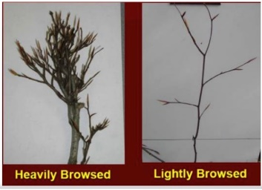
A sampling of seedlings in Wilber Park
Thanks to Donna Vogler, Professor of Biology
About 20 seedlings/sprouts sampled (everything found in a transect ~0.1 mi.), ave. size 16.25”.
Deer browse found on all but one. Average deer browse 75% (only ~25% of leaf buds remained).
Sprouts around an ash tree indicated heavy browsing for
several years.
A beech tree, an indicator species since deer generally ignore
them, showed significant browse at a height higher than deer
can easily reach.
A 49” maple sapling growing within and protected by a barberry
bush showed 60% browse.
mucc.org

Slide 21
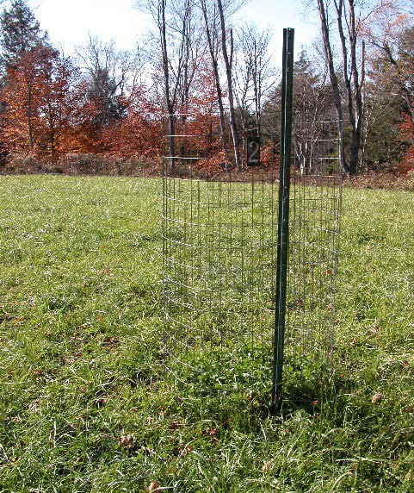
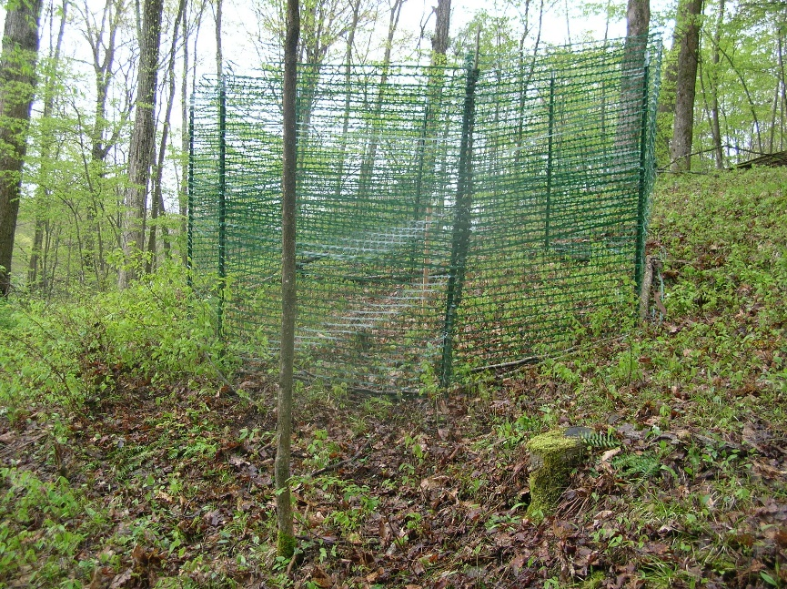
Recommendation:
Deer exclosures can help establish a baseline for what vegetation you might expect if deer browsing was not a factor.
Signage can educate the public about the purpose of the exclosures
Simple exclosure in a clover field
Exclosure around a single AVID plot in a forest

Slide 22
Erosion caused by over-browsing
Some of the steeper hills in the city are experiencing erosion, possibly caused by deer over-browsing.

Slide 23
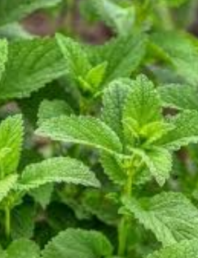
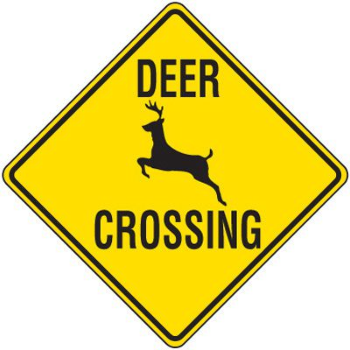
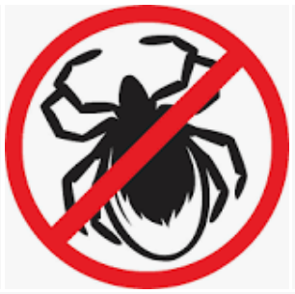
Mitigation of problems
Landscape with deer-resistant plantings
Sprays, repellents to keep deer out of yards
Fencing (8-foot fencing is costly; check for height restrictions)
These solutions may push the problems into your neighbor’s yards.
Strong-smelling plants like rosemary and mint can deter both deer and ticks.
Road signage warning of deer crossing
Lowered speed limits in appropriate areas
Stop feeding deer
Distribution of educational materials: tick bite avoidance, plantings, feeding deer

Slide 24
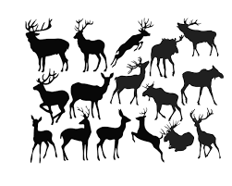
The aforementioned strategies may help to temporarily mitigate the problems but will not address the issue of overpopulation.

Slide 25
Population Reduction Measures
Translocation: capture deer, release in an area with few deer
No such areas in New York State: DEC will not allow
Costly, several hundred dollars per deer
85% of translocated deer die within a year
Sterilization: capture deer, sterilize, release
Only works in an isolated area (fenced in or island)
Costly, several hundred dollars per deer

Slide 26
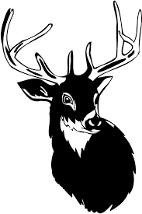
“Regulated hunting remains the most efficient means to manage deer. Adequate harvests of antlerless deer are essential to successful efforts.”
https://www.dec.ny.gov/animals/33973.html

Slide 27
Recommendations:
Encourage more hunting on the outskirts of Oneonta.
Nuisance hunting licenses from the DEC would allow hunting outside of the regular hunting season.
Educate the public on the issue
Develop a multi-year plan for the maintenance of a sustainable deer population, including impact monitoring
*
Both landowners and the city would retain the right to control who, when, and how hunting would occur.

Slide 28
The
End

Slide 29
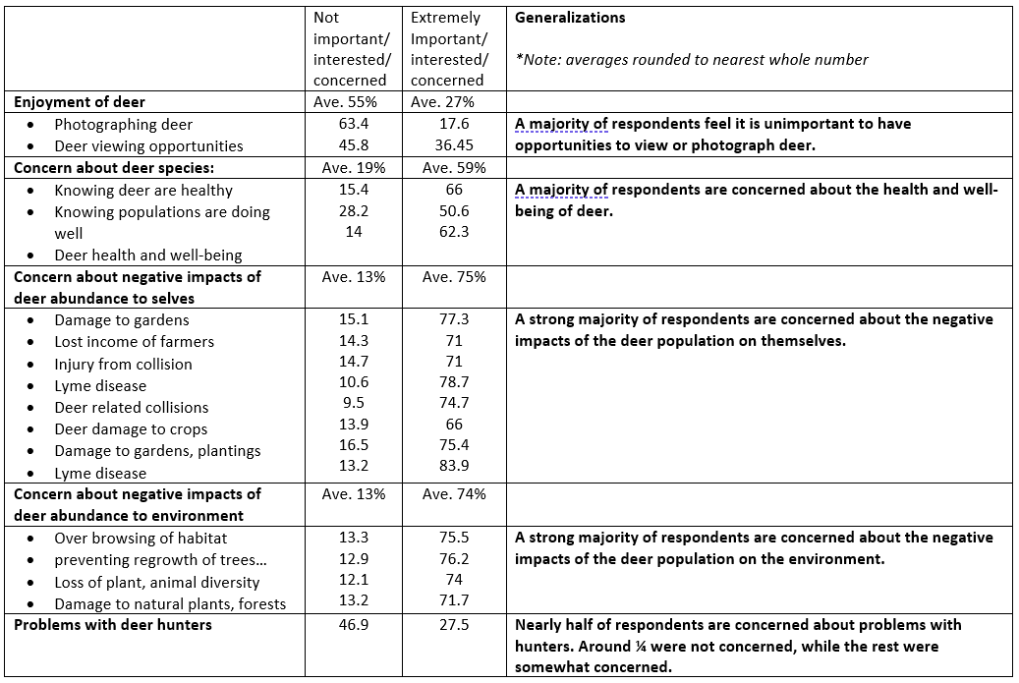
Survey Results
Detailed results are provided in the written proposal.

Slide 30
For more information visit these DEC pages:
The Deer Management Assistance Program (DMAP) provides antlerless deer harvest tags that the landowner or municipality can distribute to licensed hunters for use on specific parcels of land. The hunters can use the tags on those properties during deer hunting seasons in addition to the regular tags they receive with their licenses.
Deer Damage Permits allow taking of deer outside of hunting seasons under certain conditions, and may allow the use of specialized techniques to increase success. These permits are issued in situations where adequate population control and damage reduction cannot be achieved through hunting, even with DMAP.

